Slide 1
CUSP Capstone project
Spring 2022
Shape Estimation and Data-driven Intelligent Control of Soft Robotic Upper-limb Exoskeletons for In-home Telerehabilitation
Literature presentation
Pre-Training boosts out-of-domain robustness for pose estimation
Yinuo Zhao
Notes:
My presentation today is mainly focus on how pre-training boots out of domain robustness for the pose estimation

Slide 2
Overall Outcome
better ImageNet-performing architectures perform better on both within- and out-of-domain data if they are first pretrained on ImageNet
better ImageNet models generalize better across animal species
pre-training increases pose estimation performance in the common corruptions background shift context as well
transfer learning is beneficial for out-of-domain robustness
Notes:
This is an overall Outcome summary in this paper, it can help us better understand the logic during the presentation . The paper is mainly accomplished four things :

Slide 3
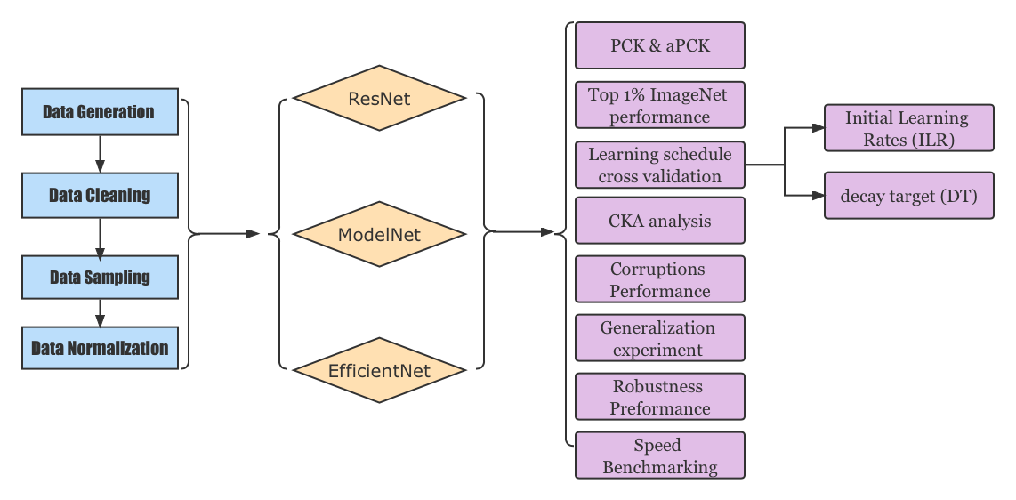
Summary Chart- Data Preprocessing，Models，Results
Model used
Key metrics & Result
Data Preprocessing Steps
Notes:
Here is a summary chart of what data preprocessing steps they use , what model (backbone)included and what result it shown in this paper

Slide 4
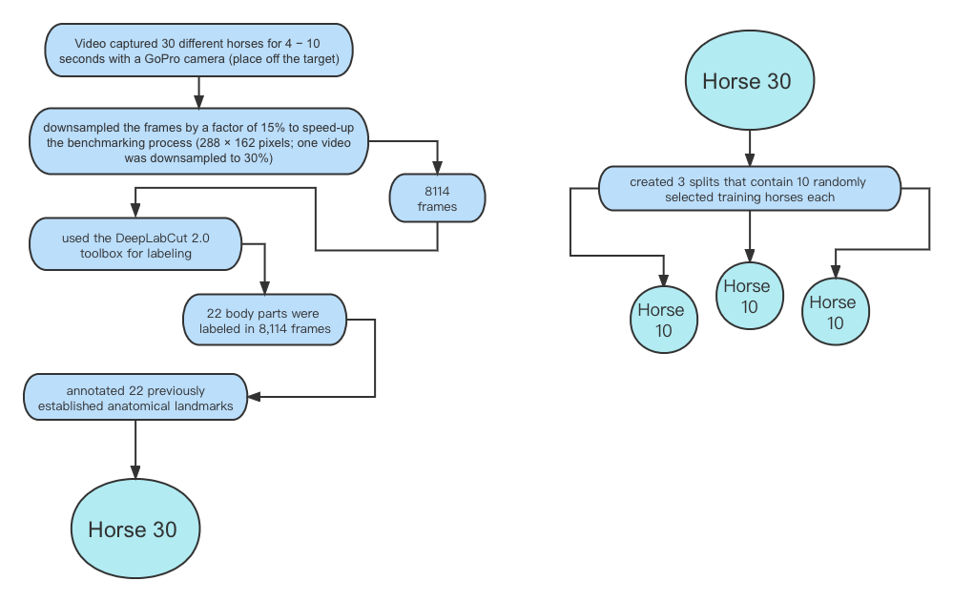
Data Generation
Notes:
I am going to start with the data preprocessing steps. The first step is data generation. The team use a GoPro Camera to capture 4-10 seconds videos for 30 different horses and the camera is place off the target. Then in order to speed-up the benchmarking process, the videos has been down sampled the frame by 15%. The total number of frames is 8114. The team use the Deeplabcut 2.0 toolbox for labeling and 22 body parts were labeled in total frames. After annotated these landmarks, our main dataset for this paper has been built. It is called Horse 30.
From Horse 30, they created 3 splits that each split contain 10 randomly selected training horses. We called it Horse 10 .It will be our major training set.

Slide 5
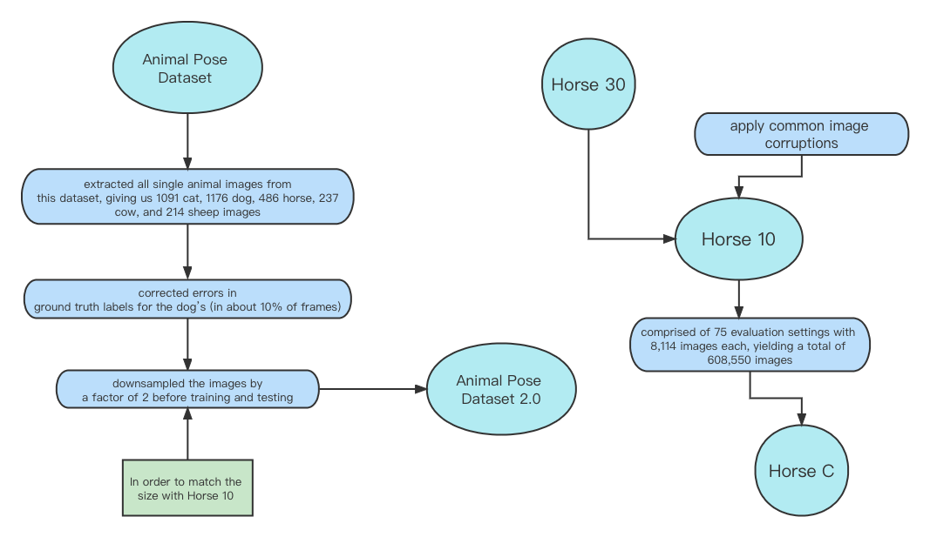
Data Generation & Data Cleaning
Notes:
There is also a datasets for the later generalization test called Animal pose dataset. They extracted all single animal images from this dataset, giving us 1091 cat, 1176 dog, 486 horse, 237 cow, and 214 sheep images, then corrected errors inground truth labels for the dog’s (in about 10% of frames). In order to match the horse size in Horse 10, they downsampled the images by a factor of 2 before training and testing and got this new version of the Animal Pose Dataset.
The Horse-C dataset is used for test robustness to image corruptions. It is derived from Horse-30 and applies common image corruptions to the Horse-10 dataset. The resulting Horse-C images are corrupted with different forms of digital transforms, blurring filters, pointwise noise or weather conditions. Horse-C consists of 75 evaluation settings with 8,114 images each, yielding a total of 608,550 images.

Slide 6
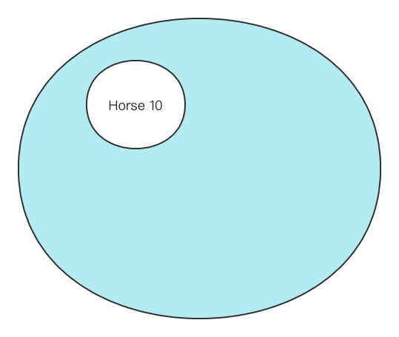
In domain data and out of domain data
Horse 30
The whole big circle is the dataset Horse 30
The white circle inside the big circle is the in-domain data Horse 10
The blue part is the out-of-domain data
Out of domain data
Train on a subset of individuals (10) and evaluate on held-out “out-of-domain” horses (20).
Notes:
There is a key factor that is very important to be understood before we continue. It is an out of domain dataset. Imagine this big circle is the horse 30 data, there is a small portion inside of it is Horse 10 . Then the rest of the horse 30 data will be out of domain.

Slide 7
ML Models – Introduction
Research process and methods
ResNets:
  Strong model
  a pretrained Deep Learning model for image classification of the Convolutional Neural Network(CNN)
MobileNetV2 Nets:
  lightweight model
  pre-trained model for image-based classification
  Pre-train the ImageNet
  utilized four variants of MobileNetV2 with different expansion ratios (0.35, 0.5, 0.75 and 1)
EfficientNet
  Powerful model
  A convolutional neural network architecture and scaling method that uniformly scales all dimensions of depth/width/resolution using a compound coefficient.
  Faster training speed and better parameter efficiency
  From B0 to B6, compound scaling is used to increase the width, depth, and resolution of the network, which directly corresponds to an increase in ImageNet performance
Notes:
Before present the model performance result , I would like to introduce these models used in the paper. First one is This 50 means 50 layers deep

Slide 8
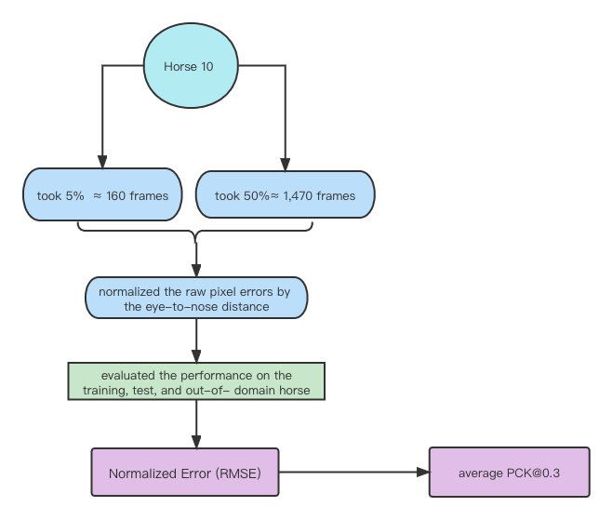
Training set
PCK 0.3: a matching threshold of 30% of the head segment length
Notes:
For each training set we took a subset of 5% (≈ 160 frames), and 50% (≈ 1,470 frames) of the frames for training, and then evaluated the performance on the training, test, and “out-of-domain”horse.
Because the horses could vary dramatically in size across frames, they normalized the raw pixel errors by the eye-to-nose distance and report the fraction of this distance which is the normalized error as well as percent correct keypoint( PCK) metric

Slide 9
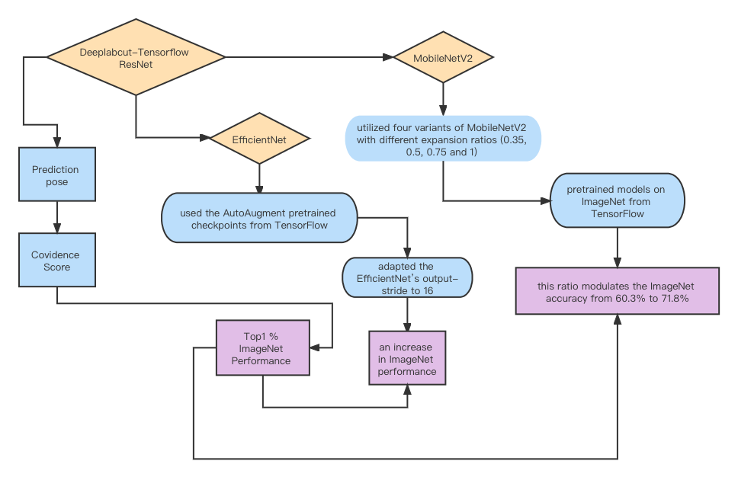
Architectures
Notes:
This is the basic architectures in this paper. They utilized the pose estimation toolbox called DeepLab- Cut, and added MobileNetV2 and EfficientNet backbones to the ResNets that were present, as well as adding imgaug for data augmentation。imgaug is a library for image augmentation
The TensorFlow-based network architectures could be easily exchanged while keeping data loading, training, and evaluation consistent. The feature detectors in DeepLabCut consist of a backbone followed by deconvolutional layers to predict pose score-maps and location refinement maps (offsets), which can then be used for predicting the pose while also providing a confidence score. This confiden

Slide 10
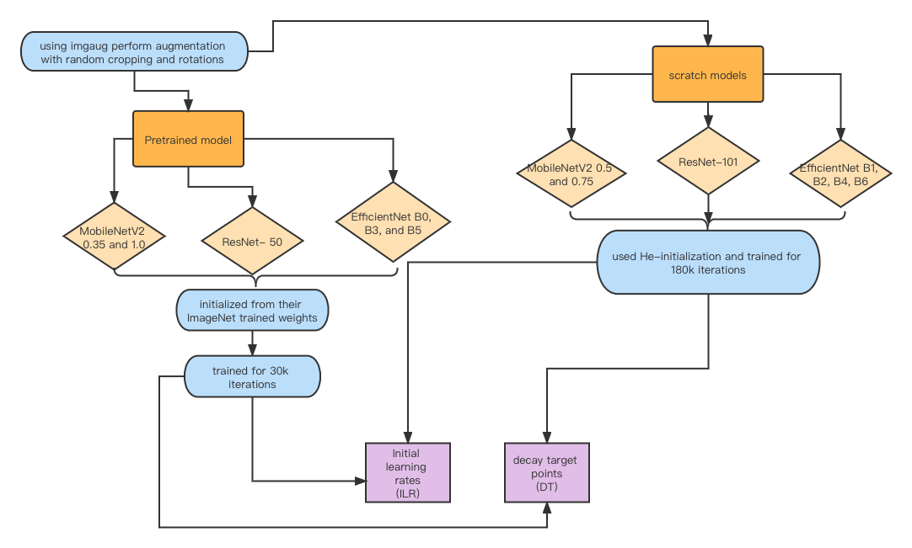
Pretrained model & Train from scratch Model
Notes:
Models has been using imgaug perform augmentation with random cropping and rotations and the separated into two groups of models：pretrained model and train form scratch model. 0.35， 0.5， 0.75 is the width multiplier， For MobileNetV2s, we trained the batch normalization layers too (this had little effect on task performance for MobileNetV2-0.35)

Slide 11
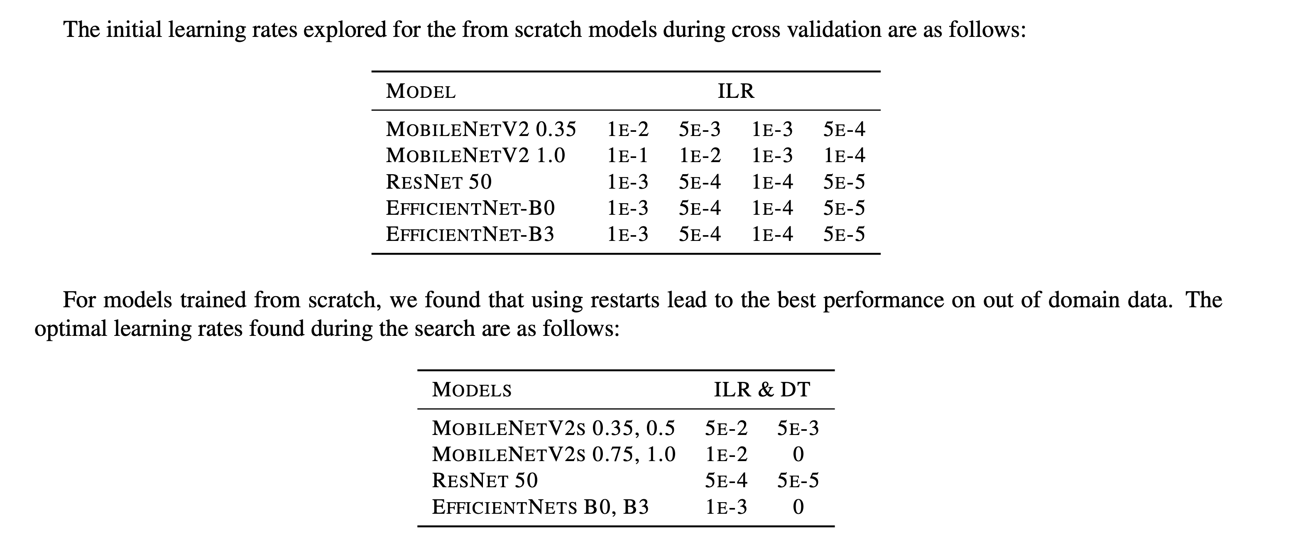
Results- Cross Validation
Research process and methods
Learning Schedules
All cross validation experiments were performed on the three splits with 50% of the data for training.
the learning rate schedule without restarts was optimal on out of domain data
started with the highest possible initial learning rate that was numerically stable for each model

Slide 12
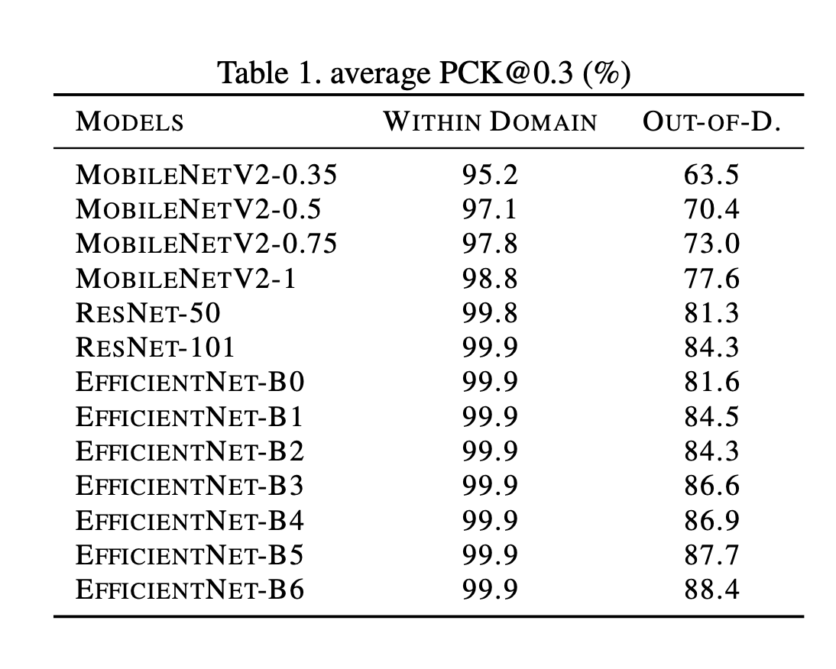
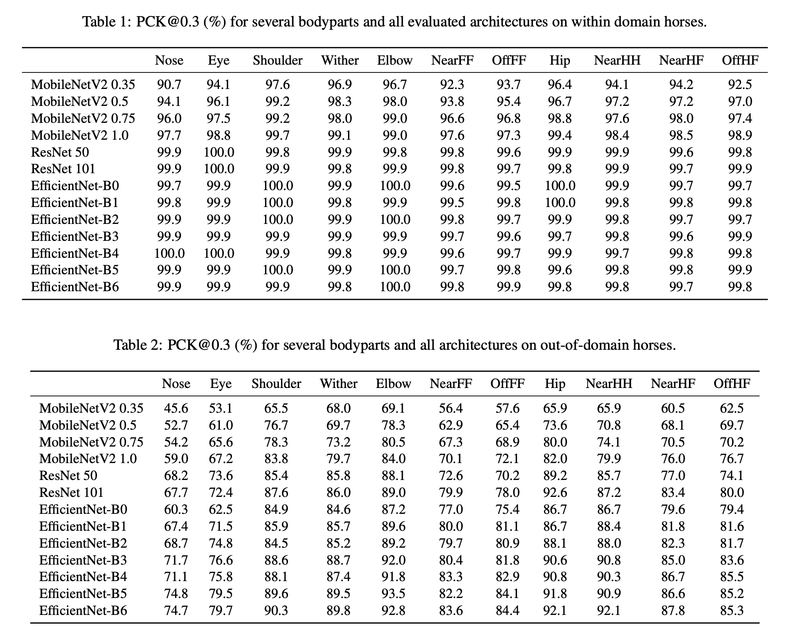
Results of the PCK
Research process and methods
all ImageNet-pretrained architectures exhibited strong performance on Horse-10 within domain（low average errors, and high aPCK)
directly compared the ImageNet performance to model respective performance on pose estimation task -- Top-1% ImageNet accuracy correlates with pose estimation test error (Linear regression slope −0.33%, R2 = 0.93, p=1.4 × 10−7 )

Slide 13
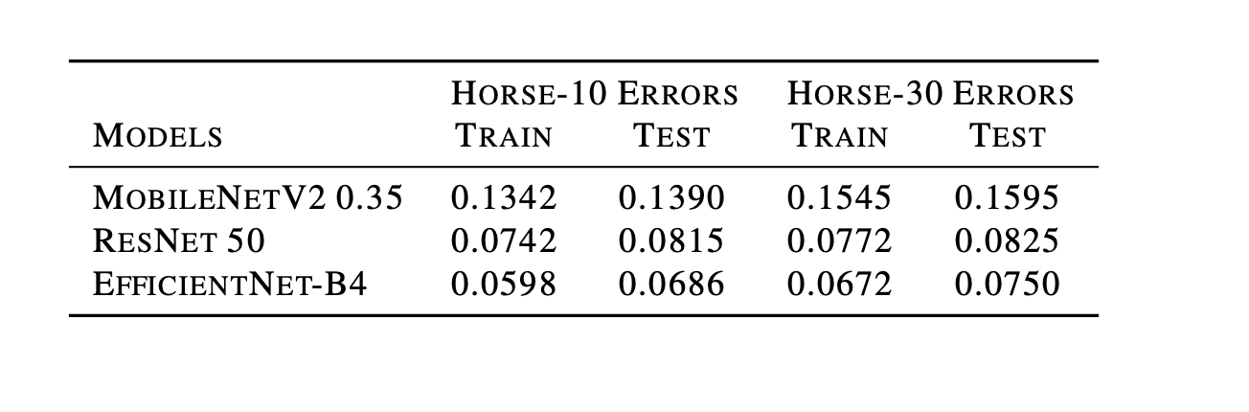
Results-Normalized Errors
Research process and methods
In order to compare the Horse 10, it provide the train and test normalized errors for models on Horse 30
Elevated Normalized Error , Calculated values between -1 and +1 are considered conforming or passing.
Train these models for twice as long (60,000 iterations) but with the same cross-validated cosine schedules from Horse-10
randomly initialized networks could closely match the performance of pretrained networks but not for smaller training sets (5% training data; 160 images)

Slide 14
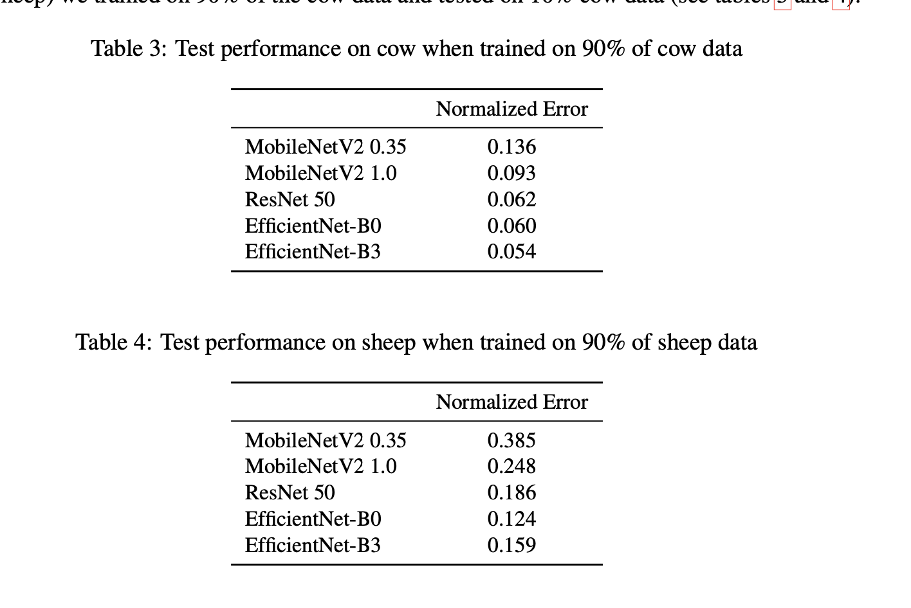
Results-Generalization experiments
Normalized Error (RMSE)
novel horses
Across Species
For the in domain data, train on only 1 species and testing on another
for each out-of-domain test species (cow and sheep) we trained on 90% of the cow data and tested on 10% cow data
comparing the linear regression slope for out- of-domain test data: −0.93% pose estimation improvement per percentage point of ImageNet performance, R2 = 0.93, p = 9 × 10−8 vs. within-domain test data −0.33%, R2 = 0.93, p = 1.4 × 10−7 (for 50% training data)
less powerful models overfit more on the training data.
Notes:
For both cows and sheep, better ImageNet architectures, trained on the pose data of other animal classes performed better, in most cases

Slide 15
Results- Similarity: CKA analysis
Research process and methods
To elucidate the differences between pretrained models and models trained from scratch, we analyze the representational similarity between the variants.
Use linear CKA to compare the image representations at various depths
Aggregate the within domain and out of domain data set, averaged over the three shuffles
early blocks are similar for from scratch vs transfer learning for both sets of horses
In later layers, comparisons between within-domain and out of domain trends were inconclusive as to why e.g., EfficientNets generalize better

Slide 16
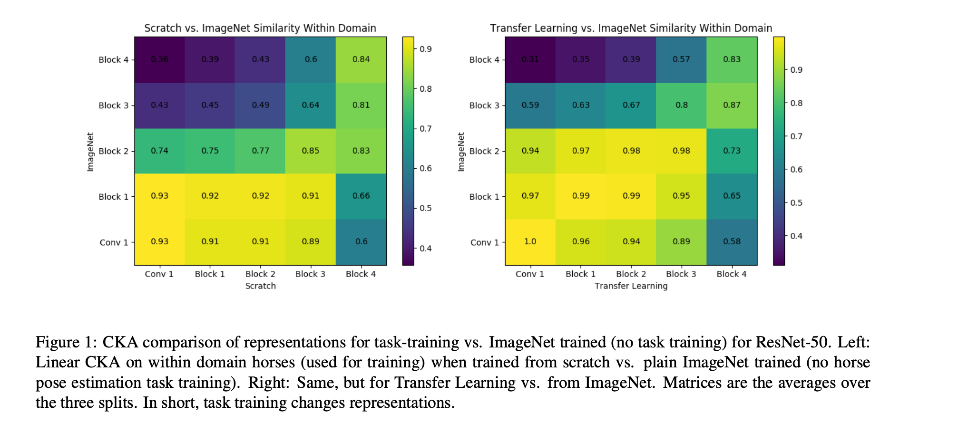

Slide 17
Results-Horse C: Robustness
Research process and methods
All models are either trained on Horse-10 from scratch or pre-trained on ImageNet and fine-tuned to Horse-10, using the three validation splits.
Results are averaged across all five severities and three validation splits of the data
using batch norm adaptation yields slightly improved performance for MobileNetV2s on clean within- domain data and deteriorates performance for EfficientNet models
Performance on clean data is improved of all model variants when training from scratch, and
Performance improved for MobileNets and ResNets when using pre-trained weights.

Slide 18
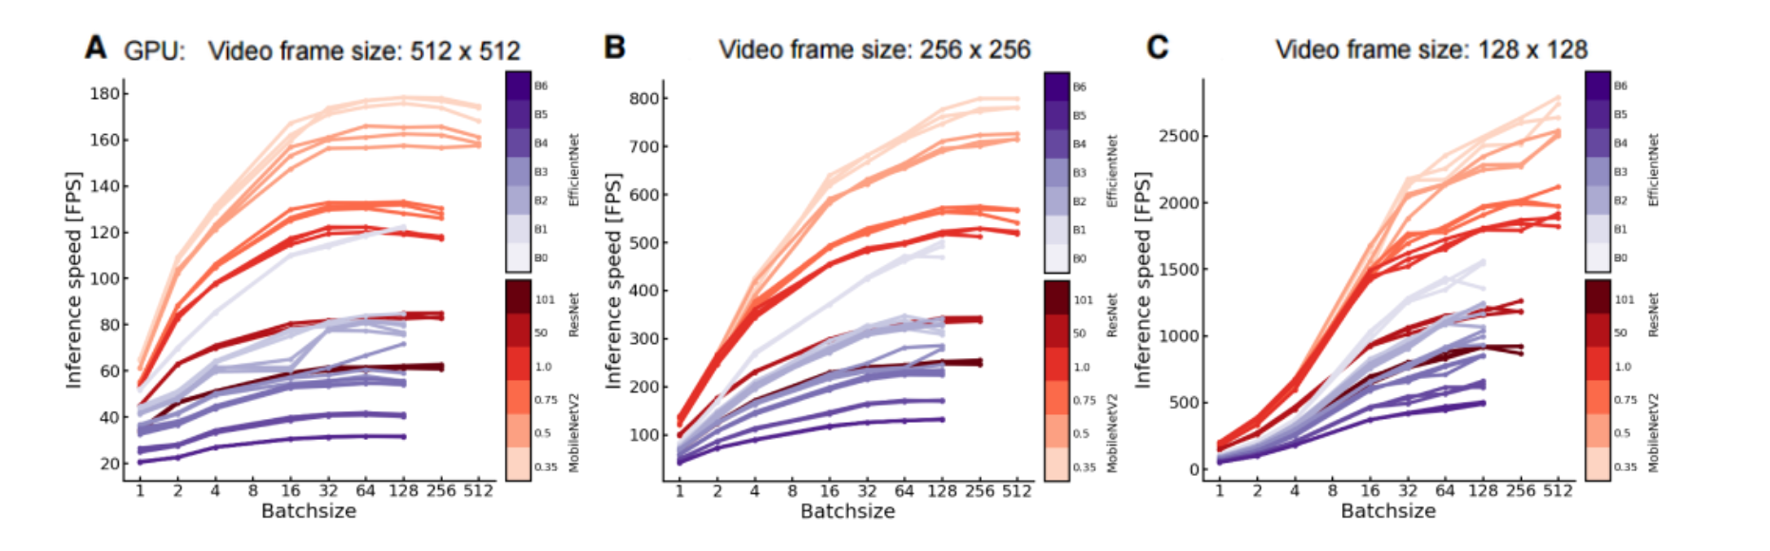
Results-Speed
Research process and methods
Use new DeepLabCut variants-----Better Accuracy and faster speed
evaluated the inference speed for one video with 11, 178 frames at resolutions 512 × 512, 256 × 256 and 128 × 128.
Used batch sizes: [1, 2, 4, 16, 32, 128, 256, 512], and ran all models for all 3 (training set shuffles) trained with 50% of the data in a pseudo random order on a NVIDIA Titan RTX.
MobileNetV2 gives a more than 2X speed improvement (over ResNet-50) for offline processing and about 40% for batchsize=1 on a Titan RTX GPU.

Slide 19
Thank You For Listening

